Slide 1

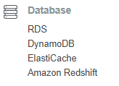
AWS Database

Slide 2
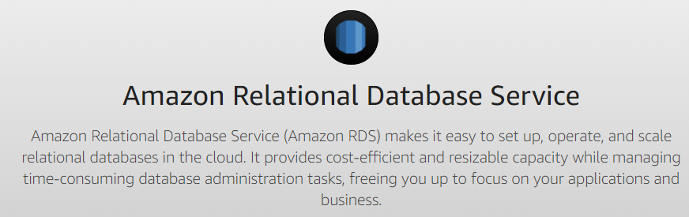
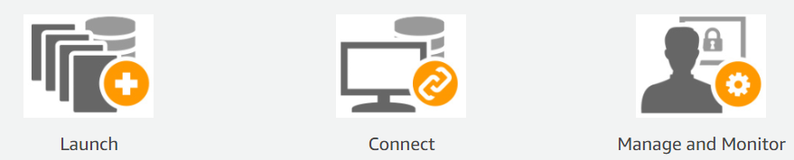
AMAZON Relational database service

Slide 3
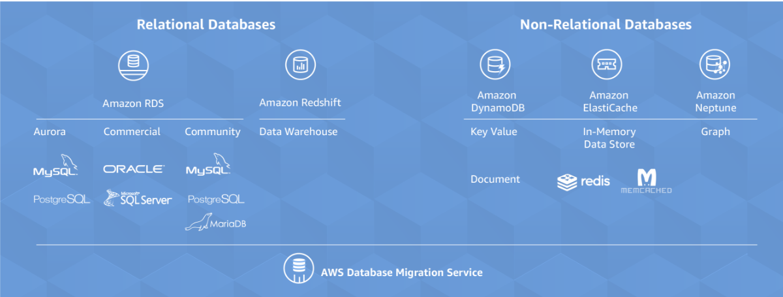
Database

Slide 4
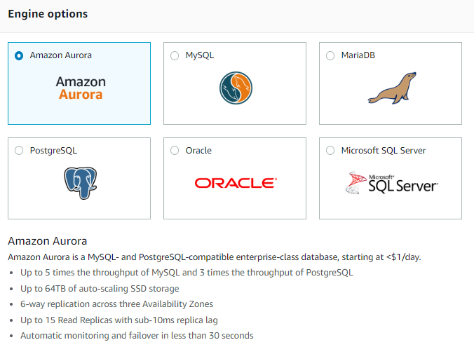
rds aURORA

Slide 5
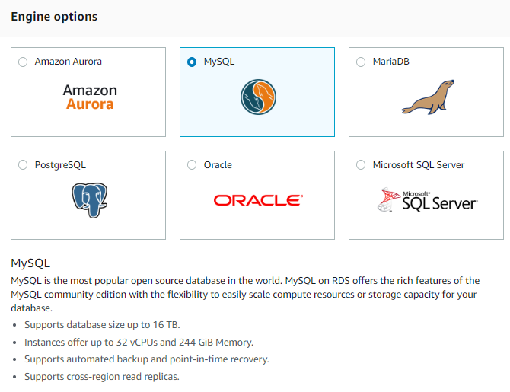
Rds mYsql

Slide 6
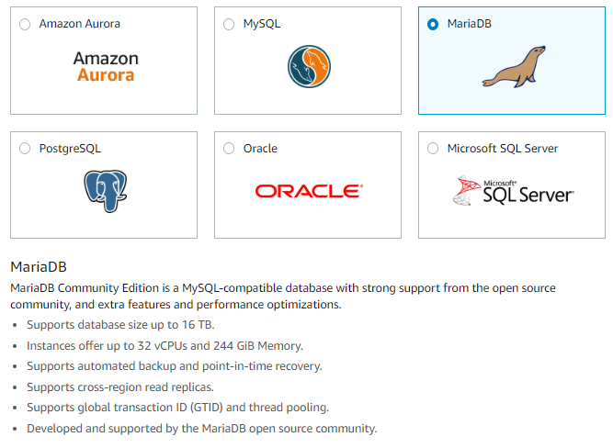
Rds mARIAdb

Slide 7
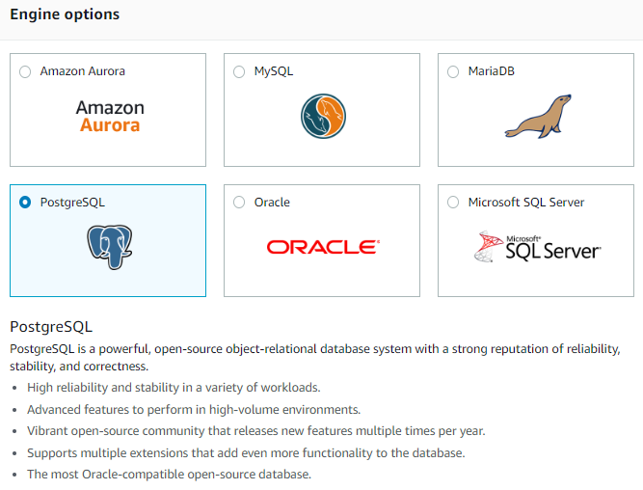
Rds pOSTGREsql

Slide 8
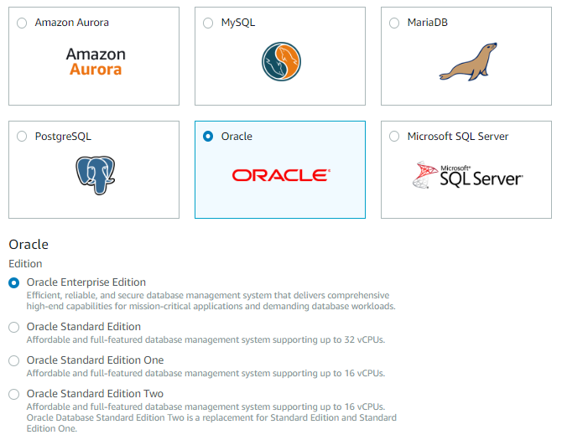
Rds oRACLE

Slide 9
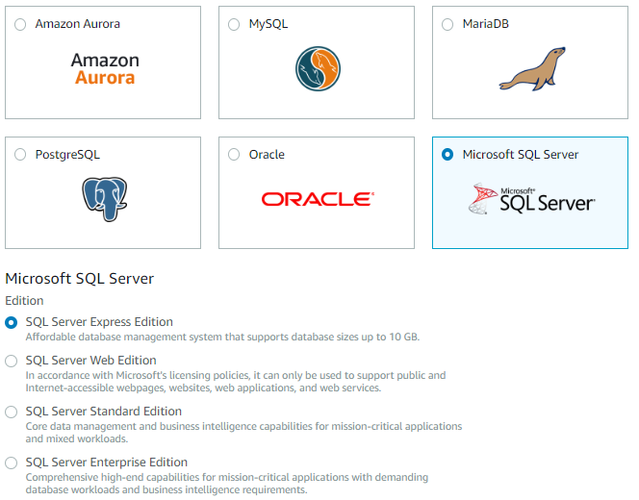
Rds Microsoft sql Server

Slide 10
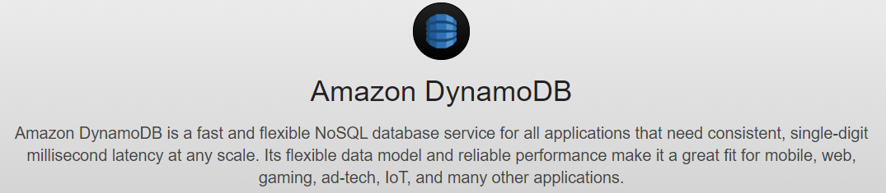
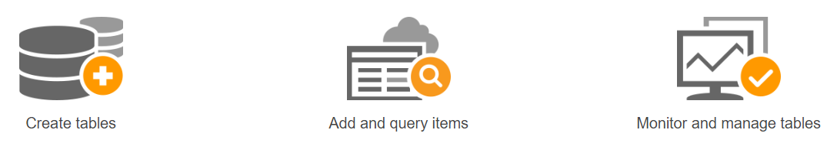
DynamoDB

Slide 11

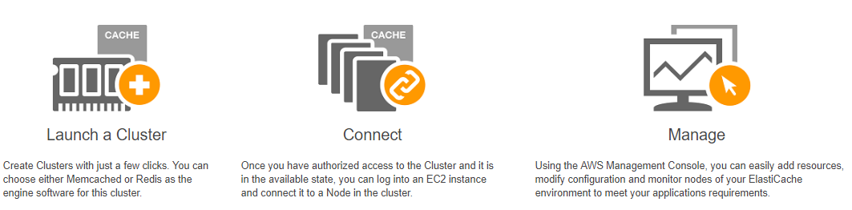
elasticache

Slide 12
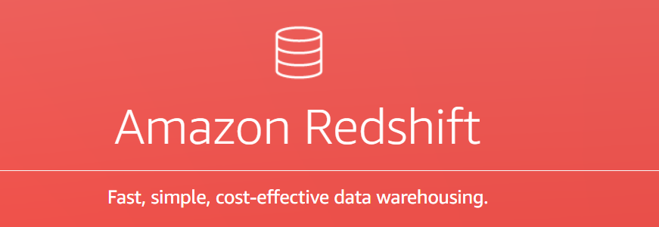
Amazon redshift
https://aws.amazon.com/redshift/
Notes:
Amazon Redshift is a fast, fully managed data warehouse that makes it simple and cost-effective to analyze all your data using standard SQL and your existing Business Intelligence (BI) tools. It allows you to run complex analytic queries against petabytes of structured data, using sophisticated query optimization, columnar storage on high-performance local disks, and massively parallel query execution. Most results come back in seconds. With Amazon Redshift, you can start small for just $0.25 per hour with no commitments and scale out to petabytes of data for $1,000 per terabyte per year, less than a tenth the cost of traditional solutions.
Amazon Redshift also includes Redshift Spectrum, allowing you to directly run SQL queries against exabytes of unstructured data in Amazon S3. No loading or transformation is required, and you can use open data formats, including Avro, CSV, Grok, Ion, JSON, ORC, Parquet, RCFile, RegexSerDe, SequenceFile, TextFile, and TSV. Redshift Spectrum automatically scales query compute capacity based on the data being retrieved, so queries against Amazon S3 run fast, regardless of data set size.

Slide 13
How to stop and start RDS by script
https://www.codeproject.com/Articles/1190194/Start-Stop-RDS-instances-on-schedule
https://www.cloud-tech.io/2017/08/automate-rds-start-and-stop-with-lambda.html

